Slide 1
A Brief introduction to R package WORDCLOUD 2
Alex Guo and Longyuan Gao

Slide 2
outline
Introduction
Why choosing wordcloud
Before we start: from raw text to word counts
WORDCLOUD 2 Package & Code Examples
Summary

Slide 3
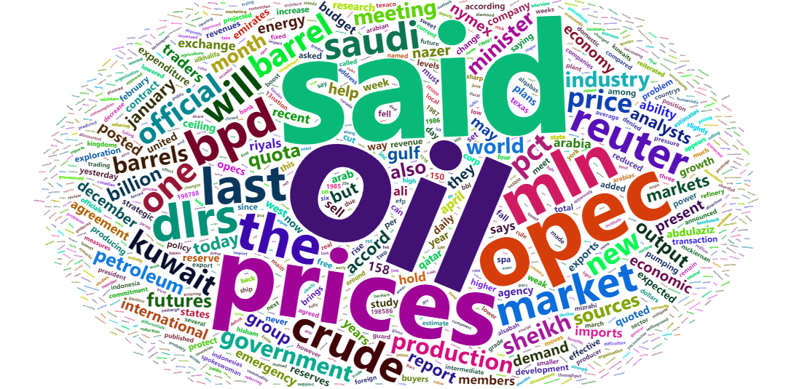
INTRODUCTION
A sample wordcloud generated from dataset “demoFreq”
A wordcloud is an electronic image that shows words used in a particular piece of electronic text or series of texts. The words are different sizes according to how often they are used in the text.
[Cambridge English Dictionary]

Slide 4

Wordcloud: an example
“Alone, alone, all all alone, Alone on a wide, wide sea."
—Samuel Coleridge, "The Rime of the Ancient Mariner"
result
Word | Count
Alone | 4
All | 2
Wide | 2
On | 1
A | 1
Sea | 1

Slide 5
But… why wordclouds?
Although less used in rigorous EDAV, a wordcloud can...
1. Better visualize topic discussed in text
2. Help distill important information
3. Communicate ideas to more general audience
....

Slide 6


Before we start on wordclouds, there is one step missing…
Raw Text
Word Count DATAFRAME
Result Wordcloud
“Alone, alone, all all alone, Alone on a wide, wide sea.”
Word | Count
Alone | 4
All | 2
… | …
?

Slide 7
Example text
“Students should be aware that academic dishonesty (for example, plagiarism, cheating on an examination, or dishonesty in dealing with a faculty member or other university official) or the threat of violence or harassment are particularly serious offenses and will be dealt with severely under Dean’s Discipline.
Graduate students are expected to exhibit the high level of personal and academic integrity and honesty required of all members of an academic community as they engage in scholarly discourse and research.
Scholars draw inspiration from the work done by other scholars; they argue their claims with reference to others’ work; they extract evidence from the world or from earlier scholarly works. When a student engages in these activities, it is vital to credit properly the source of his or her claims or evidence. Failing to do so violates one’s scholarly responsibility…”
- https://www.gsas.columbia.edu/content/academic-integrity-and-responsible-conduct-research, Academic Integrity and Responsible Conduct of Research, Columbia University.

Slide 8
From text to word count
Step1: Read raw text
code <- readLines(“.\\conductCode.txt”)
Step2: Convert lines to one long string
code <- paste(code, collapse = " ")

Slide 9
From text to word count
Step3: Use Regex to extract all words
code <- stri_extract_all_regex(code, "(\\w+[[:punct:]]\\w+)|(\\b\\w+\\b)")))
code <- lapply(code, tolower)
Sidenote: 1. stri_extract_all_regex is from r package stringi. There are many other regex extractors like str_detect in tidyverse.
2.(\\w+[[:punct:]]\\w+) is used to extract words with ‘ in them, such as “one’s” or “what’s”, and (\\b\\w+\\b) is used to extract all other words. You can try other regexes yourself.
Step4: Convert code to table (or DF)
code <- table(code)
or
code <- data.frame(table(code))

Slide 10
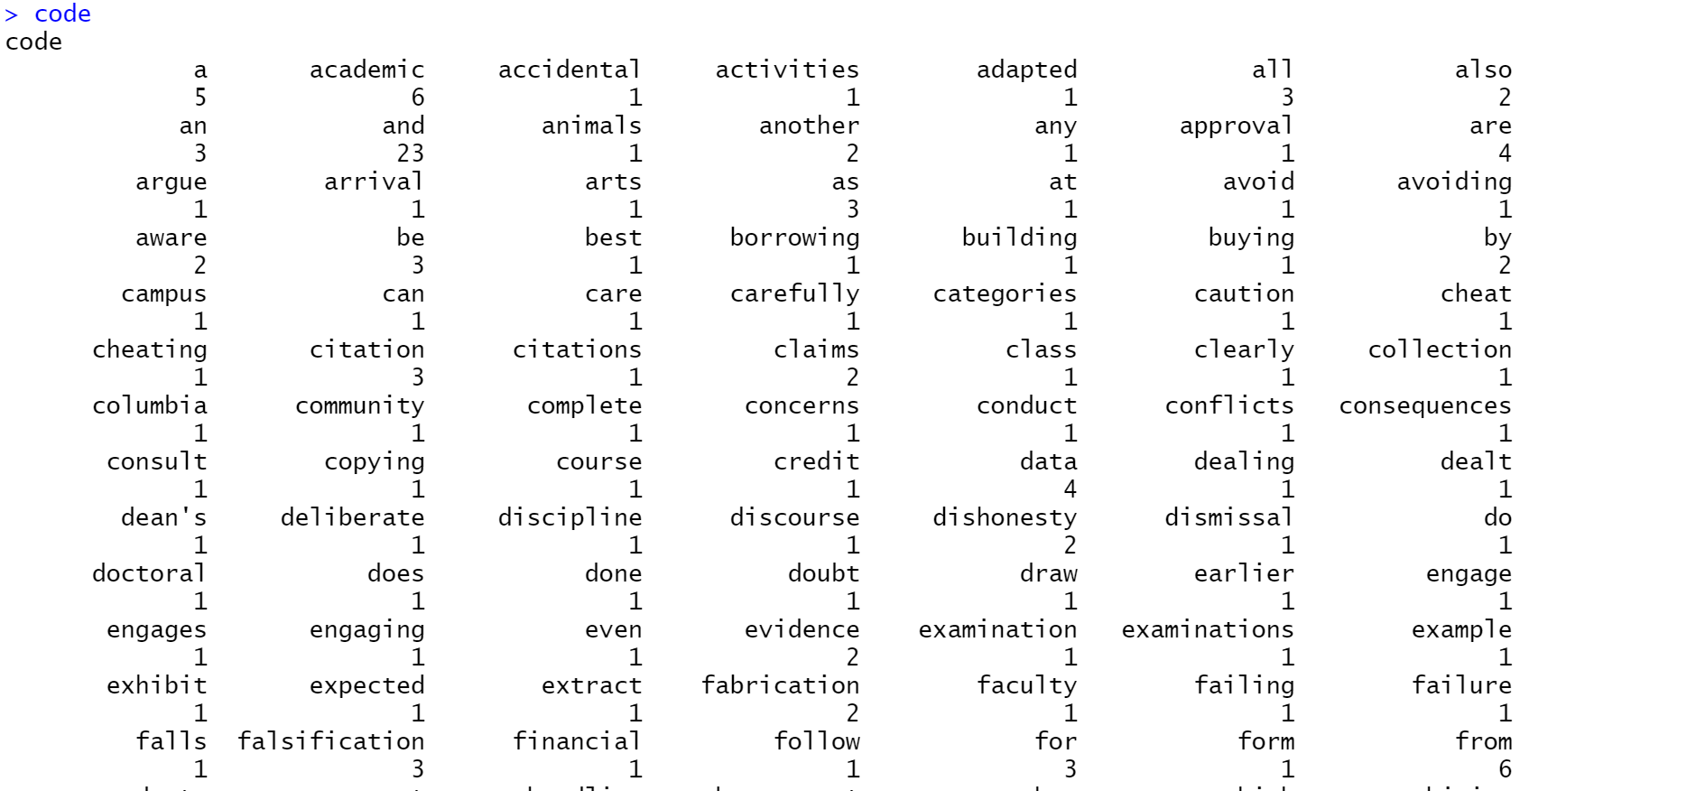
Result
code<-readLines(".\\conductCode.txt")
code <- paste(code, collapse = " ")
code <- stri_extract_all_regex(code, "(\\w+[[:punct:]]\\w+)|(\\b\\w+\\b)")
code <- lapply(code, tolower)
code <- table(code)
A table of words in the text associated with the frequency the word appears

Slide 11

Now we can start drawing wordclouds…
Raw Text
Word Count DATAFRAME
Result Wordcloud
“Alone, alone, all all alone, Alone on a wide, wide sea.”
Word | Count
Alone | 4
All | 2
… | …
√
?

Slide 12
WORDCLOUD2 Package
https://cran.r-project.org/web/packages/wordcloud2/vignettes/wordcloud.html

Slide 13
Installation
require(devtools)
install_github("lchiffon/wordcloud2")

Slide 14
Two main functions in this package
{
wordcloud2:
provide traditional wordcloud with HTML5
letterCloud:
provide wordcloud with selected word or letters (masking)

Slide 15
wordcloud2 function
Word Count DATAFRAME
Result Wordcloud
Word | Count
Alone | 4
All | 2
… | …
Wordcloud2(df)

Slide 16
Some parameters in Wordcloud2 (function)
size
Default=1, font size
fontFamily
Font to use
color
Text color theme, “random-dark” or “random-light”, or color vectors
min/maxRotation
If word rotats, the min/max (in rad) the text should rotate
shape
The shape of the result cloud. Some keywords are “circle”(default), “cardioid”, “diamond”, “triangle”,etc
figPath
A figure used for masking the wordcloud
…..

Slide 17
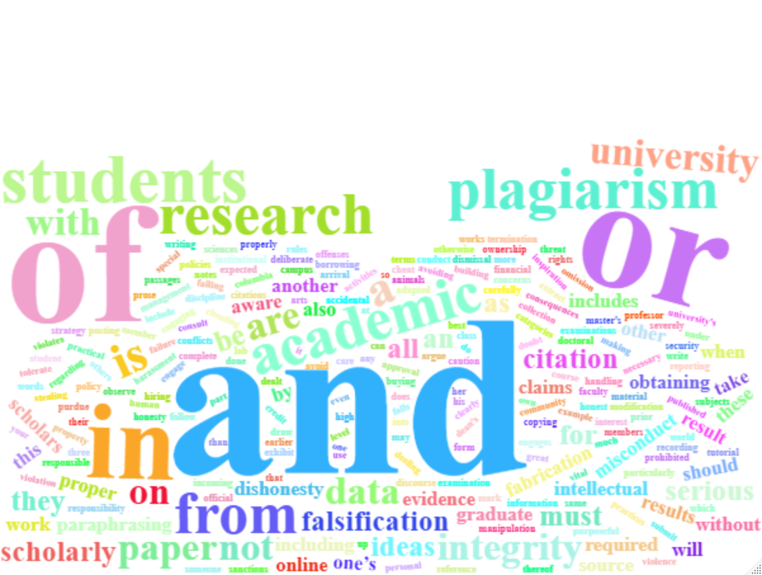
An example using conduct code
wordcloud2(data = code,
color = "random-light",
fontFamily = "Times New Roman",
shape="cardioid")
Sidenote: notice conjunction or other function words (and, or, of, etc) make up a good portion of the wordcloud. You can consider filtering these words before making word clouds.

Slide 18
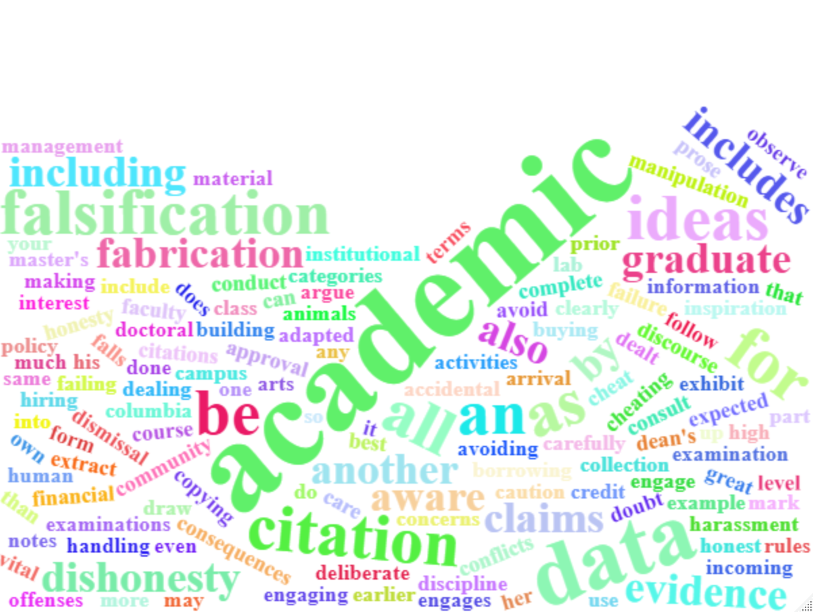
Digression: filtering out function words
code<-data.frame(code)
filterwords <- c("and", "a", "of","or", "is","are","in","from","the","on","at","in","not") #list of unwanted words
filterwords <- paste(c("^",paste(filterwords,collapse = "$|^"),"$"),collapse = "")
code <- code %>% dplyr::filter(!grepl(filterwords,code))
Sidenote: There might be easier ways!
Wordcloud with some function words filtered out

Slide 19
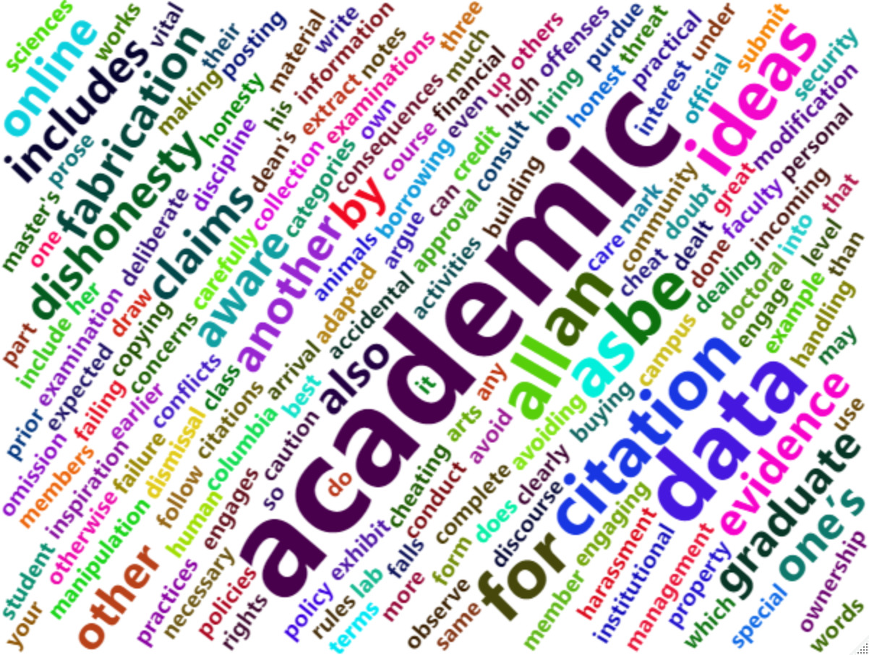
An example (Rotation params)
wordcloud2(data = code,
minRotation = pi/4,
maxRotation = pi/3,
rotateRatio = 1)
Sidenote: rotateRatio: the probability that a word rotates with give limits. If it is set to 1, then every word will rotate.

Slide 20

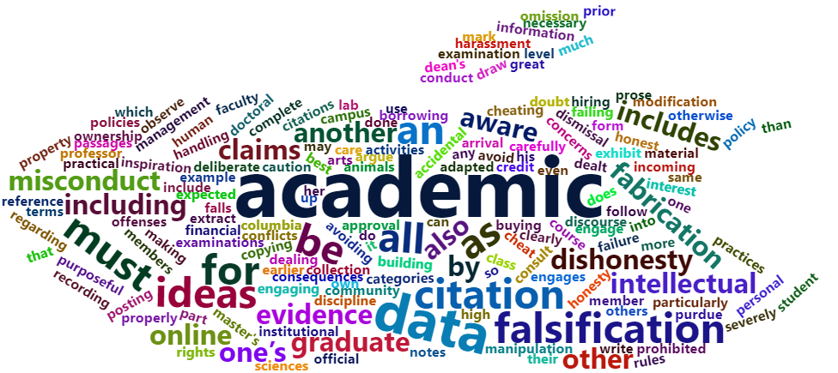
An example (figure mask)
wordcloud2(data = code,
figPath = "./Apple_logo_black.svg.png")
Mask Source:
https://commons.wikimedia.org/wiki/File:Apple_logo_black.svg

Slide 21



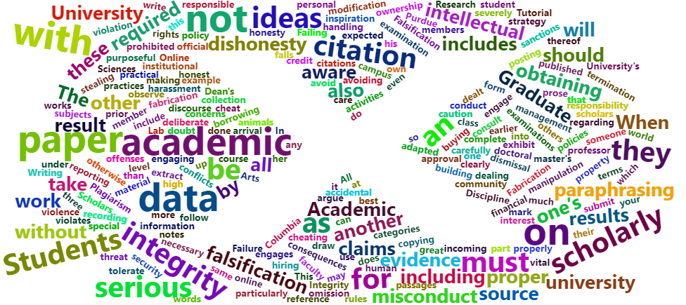
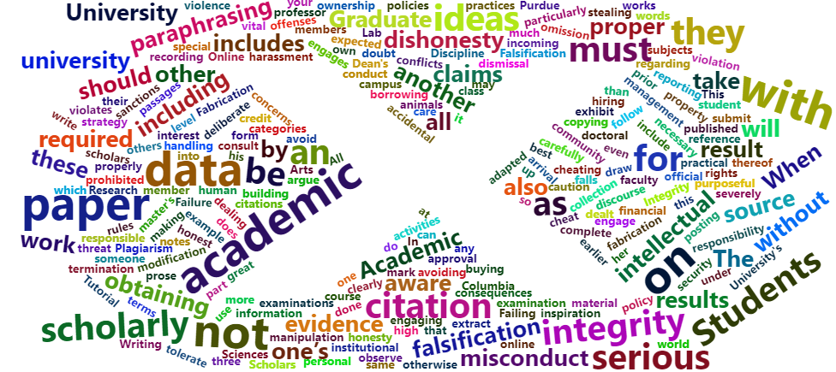
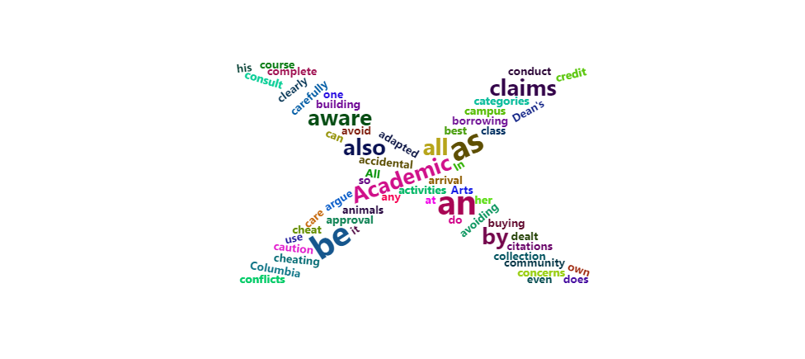
A note on figpath
When using figures to mask wordclouds, please make sure the object you want to use for masking is “darker” than the background. The package will render wordclouds in darker areas.
X is the background
X is the background
X is masked

Slide 22
letterCloud function
Requires a “word” argument
1. Word Count DATAFRAME
Result Wordcloud
2. WORD OR LETTER MASK
letterCloud(df, word=…)

Slide 23
Some parameters in lettercloud
word
A required argument. Creates shape for wordcloud
wordSize
Default=2. Parameter of size of the word.
letterFont
Set font.
…
Other parameters same as wordCloud2 function.

Slide 24
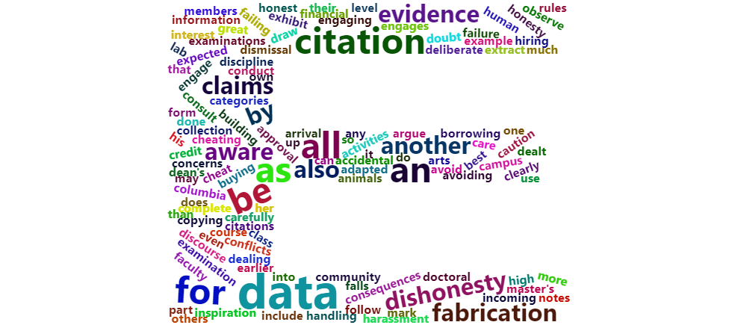
An example: letter mask
letterCloud(code,
word ="E",
wordSize = 2)

Slide 25
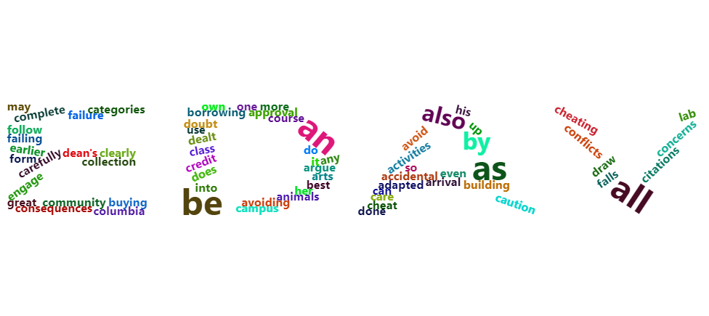
An example: word mask
letterCloud(code,
word ="EDAV",
wordSize = 2)

Slide 26
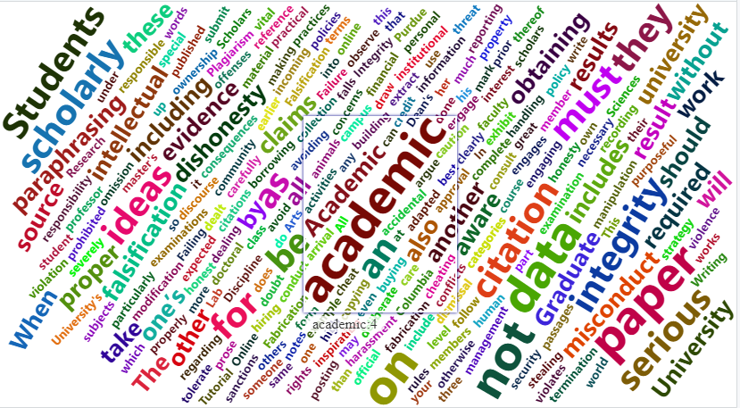
Other functionalities
Hover your mouse on any word in a rendered word. It will show you the frequency that word appears in the text!

Slide 27


Potential bugs
Sometimes wordclouds with figPath or word arguments set may not render in Rstudio viewer. Possible fixes are:
- Open into browser and refresh if not shown (recommended by author)
- Hit refresh button in Rstudio viewer few times until cloud appears

Slide 28
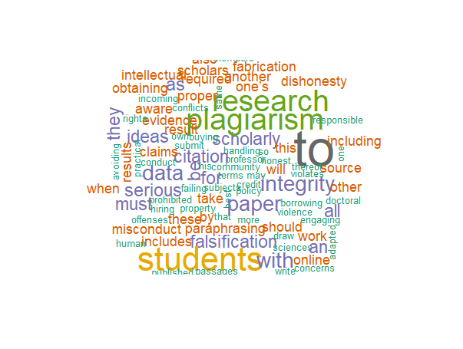
Extension: other libraries
There are other libraries in R that can generate wordclouds.
For example, using wordcloud library, we can generate wordclouds with words only lying horizontally or vertically, which is not possible in wordcloud2.
wordcloud(code$code,code$Freq,
min.freq = 1,
max.words = 100,
colors=brewer.pal(14, "Dark2"))

Slide 29
SUMMARY
Wordcloud is a powerful visualization tool for communicating ideas with the mass
Wordcloud2 is an easy-to-use and versatile R package that can help you make beautiful wordclouds.
Two main functions in Wordcloud2: wordcloud2(), which requires only a word count dataframe and letterCloud() which requires a word count dataframe and a word or letter mask.

Slide 30
THANK YOU
Alex Guo and Longyuan Gao

